Slide 1

Managing and Understanding Text Data

Slide 2

Contents & Structure
Possible noises in the text dataset
Preprocessing techniques

Slide 3
Possible noises of text data
In natural language processing (NLP) and other text-based machine learning tasks, the quality and cleanliness of textual data play a critical role in determining model performance.
However, real-world text data often contains various forms of "noise" — unwanted, irrelevant, or misleading information — that can hinder analysis and reduce the effectiveness of automated systems.
They are especially prevalent in user-generated content like social media posts, online reviews, and forum discussions.

Slide 4
Possible noises of text data
When working with text data, "noise" refers to any unwanted or irrelevant information that can hinder analysis or model performance.
Spelling Errors & Typos:
Example: "recieve" instead of "receive“.
Can cause token mismatches or reduce model accuracy.
Grammatical Errors:
Example: He go to store instead of He goes to the store
Affects syntactic parsing and language understanding.

Slide 5
Possible noises of text data
When working with text data, "noise" refers to any unwanted or irrelevant information that can hinder analysis or model performance.
Abbreviations, and Acronyms:
Example: brb (be right back), u instead of you
Hard to interpret for models not trained on such language.
Typos and Random Characters:
Example: I loooove this!, adjsdkfjsd
Often found in informal texts, e.g., social media.

Slide 6
Possible noises of text data
When working with text data, "noise" refers to any unwanted or irrelevant information that can hinder analysis or model performance.
Non-standard Capitalization:
Example: ThiS Is A tEsT
Affects tokenization and named entity recognition.
HTML Tags / XML Tags / Markup:
Example: <div>, &nbsp;
Common in web-scraped data.

Slide 7
Possible noises of text data
When working with text data, "noise" refers to any unwanted or irrelevant information that can hinder analysis or model performance.
Stop Words and Filler Words:
Words like the, is, um, uh
Often removed for certain analyses, though context-dependent.
Emojis and Emoticons:
Example: 😊, 😂
Can be meaningful or noise depending on task.

Slide 8
Possible noises of text data
When working with text data, "noise" refers to any unwanted or irrelevant information that can hinder analysis or model performance.
Duplicated Characters or Words:
Example: soooooo good, yes yes yes!
Can introduce redundancy or exaggeration.
Language Code-switching | Mix of Languages:
Switching between languages in the same sentence.
Example: "Estoy happy today“ Adds complexity to language models.

Slide 9












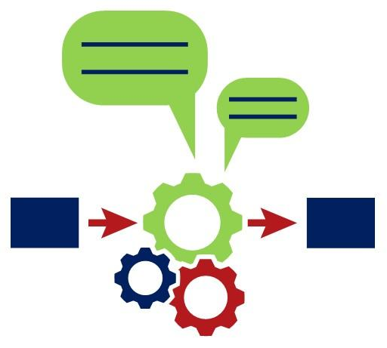





Preprocessing steps of text data
Text Normalization
Text Cleaning
Tokenization
Remove Stopwords
In English
IMDB Movie Reviews & Sentiments
Normalized Text
Remove Punctuations
Remove HTML | XML Tags
Remove URLs
Interpret Emojis | Emoticons
Correct Spellings
Handle Abbreviations
Tokens
Cleaned Tokens
Lemmatization with
POS tagging
Translate if not in English else Proceed
Word Embedding
Character Encoding
Language Detection
Word Vectors
Lemma
Raw
IMDB Movie Reviews & Sentiments
Detect the characters
are English
Detect the language
is English

Slide 10


Review Questions
What are the possible noises of a text data?
What are steps involved in text preprocessing?

Slide 11
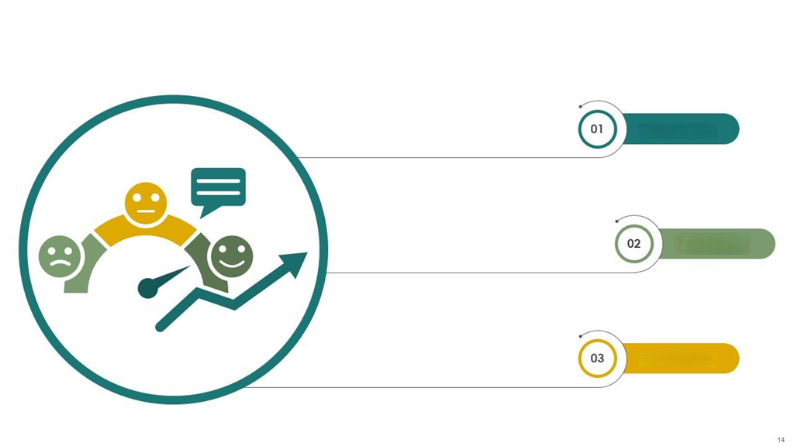
Recap of Main Points
Several noises are available in text data.
Handling these noises are very important in building a more reliable machine learning model.
Suitable NLP libraries and its functions are supposed to be used to preprocess of the text data.

Slide 12


Thank You!
You can reach me at:
raheem@apu.edu.my
https://www.linkedin.com/in/mafas-raheem/

